Slide 1
1) Anti theft alarm
Be secure always.

Slide 2
Introduction
INSPIRATION:
Reliable system which is low maintenance.
Various purposes at various places to protect theft.
Easily installable by the buyer himself.
For example: used in residency, industrial and rural areas.
AIM:
Our aim is to build a reliable and cheap alarm to detect unauthorized access into your property.

Slide 3
Block Diagram
Power Supply
Switching Circuit
Loop
Alarm
&
Circuit Indicator

Slide 4
Concept and working
This circuit uses a simple wire loop as sensor.
Use to protect any device against theft, or as a door opening alarm.
Triac is used as the switching device. Transistor is used to drive the gate of Triac.
Sensing loop is closed, base of transistor is pulled down to ground.
When the loop breaks it forward-biases the transistor.
Triac gets its gate current and the buzzer sounds.

Slide 5
Components
BT136 : TRIAC
BC547 : NPN Transistor
5V Relay
Resistors
5mm Led
5mm Screw terminal block
On/Off Switch

Slide 6
Related documents
Schematic:
1) ATA\ATA_Schematic
Simulation:
1) ATA\ATA_Simulation
PCB Layout:
1) ATA\ATA_PCBlayout
Datasheets:
1) ATA\ATA_Datasheets

Slide 7
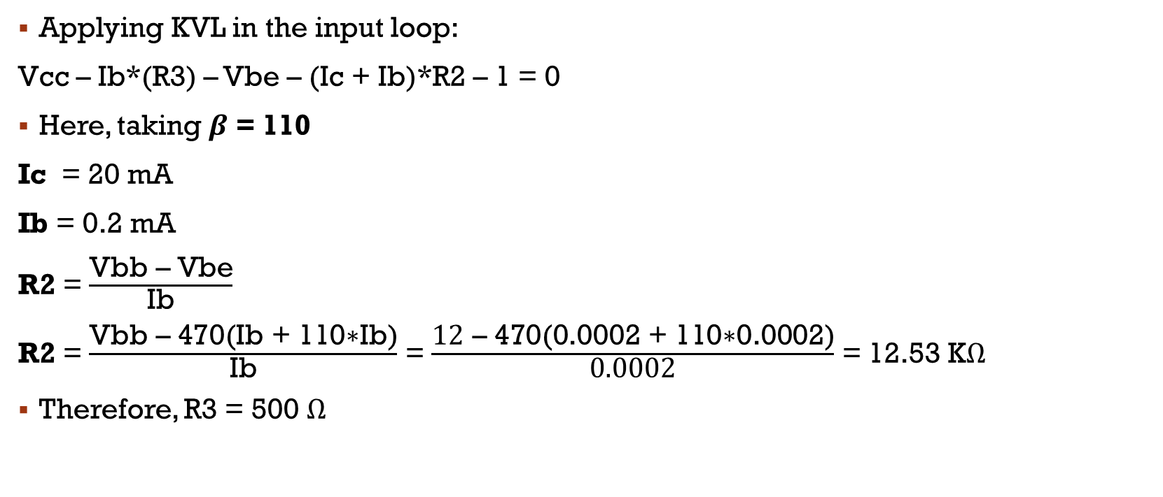
calculations
Applying KVL in the input loop:
Vcc – Ib*(R3) – Vbe – (Ic + Ib)*R2 – 1 = 0
Here, taking $β$ = 110
Ic = 20 mA
Ib = 0.2 mA
R2 = $\frac{\text{Vbb}\text{ – }\text{Vbe}}{\text{Ib}}$
R2 = $\frac{\text{V}\text{bb}\text{ – 470(}\text{Ib}\text{ + 110∗}\text{Ib}\text{)}}{\text{Ib}}$ = $\frac{\text{12}\text{ – 470(}\text{0.0002}\text{ + 1}\text{1}\text{0∗}\text{0.0002}\text{)}}{\text{0.0002}}$ = 12.53 KΩ
Therefore, R3 = 500 Ω

Slide 8
Limitations
1) Loop has to be refitted every time a break-in occurs.
2) In certain cases it has to be fitted at a proper height.

Slide 9
Advantages
1) Reliable system which is low maintenance.
2) Various purposes at various places to protect theft.
3) Easily installable by the buyer himself.

